Slide 1
Digital Business and E-Commerce Management
Lesson 11
Setting a Wix Site Part 2

Slide 2
Setting a Wix Site Part 2
At the end of this lesson, you will be able to
Customize the Wix Site
Tune-up site for mobile devices
Create Other Pages and Customize site navigation
Add a Blog

Slide 3
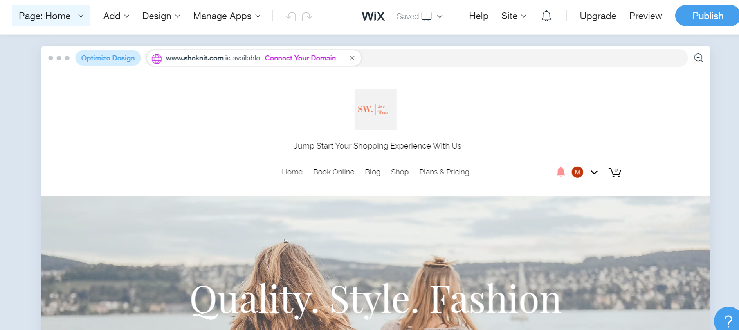
Customizing the site
After picking the homepage you like, With the Wix ADI editor you can customize every little detail about how the website appears and what elements it features.

Slide 4
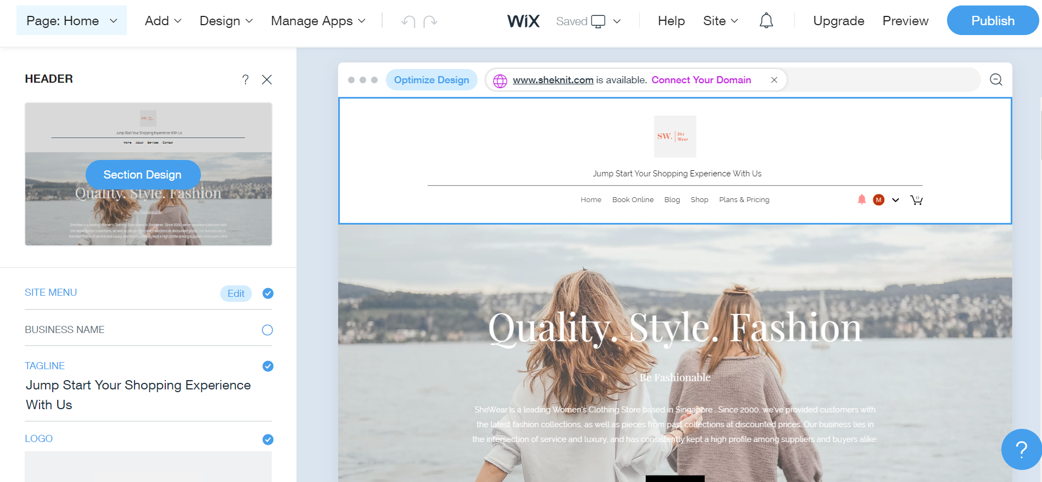
Customizing the site
For example, we click on the header section. A sidebar appeared letting you edit the site menu, tagline, logo and etc.

Slide 5
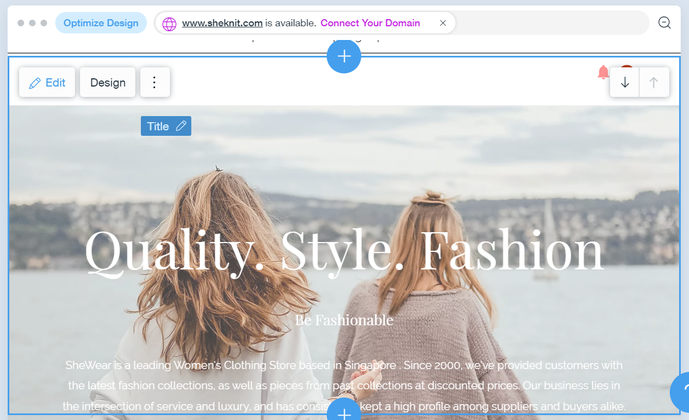
Customizing the site (Realigning the Sections)
If you look at any of the sections, you’ll see two arrow icons in the top right corner of the section.
These arrows let you move a given section up and down. Just click on them, and you’ll see your section shifting places in a matter of seconds.
The Wix ADI editor lets you drag and drop individual elements around the page and also change the order of the sections.

Slide 6
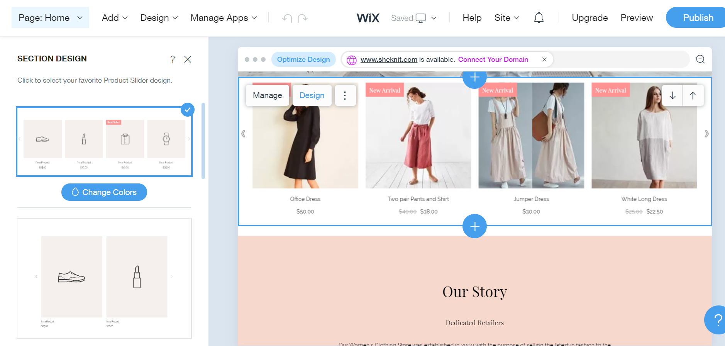
Customizing the site (Switching the Design Styles of the Sections)
Apart from editing what’s inside your content sections, you can also change the overall designs of the sections themselves.
Just pick the one you like best, and, with one click, it’s going to be put in place of the old one.

Slide 7
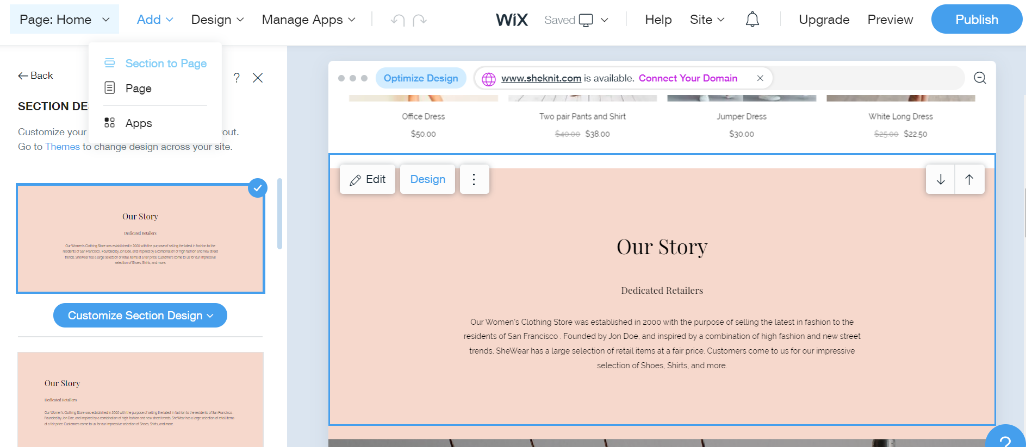
Customizing the site (Adding New Sections)
Customizing the sections that are already on the page is one thing, but you can also add new ones.
To do so, click on the Add button that’s in the top menu, and then click on “Section to Page.”

Slide 8
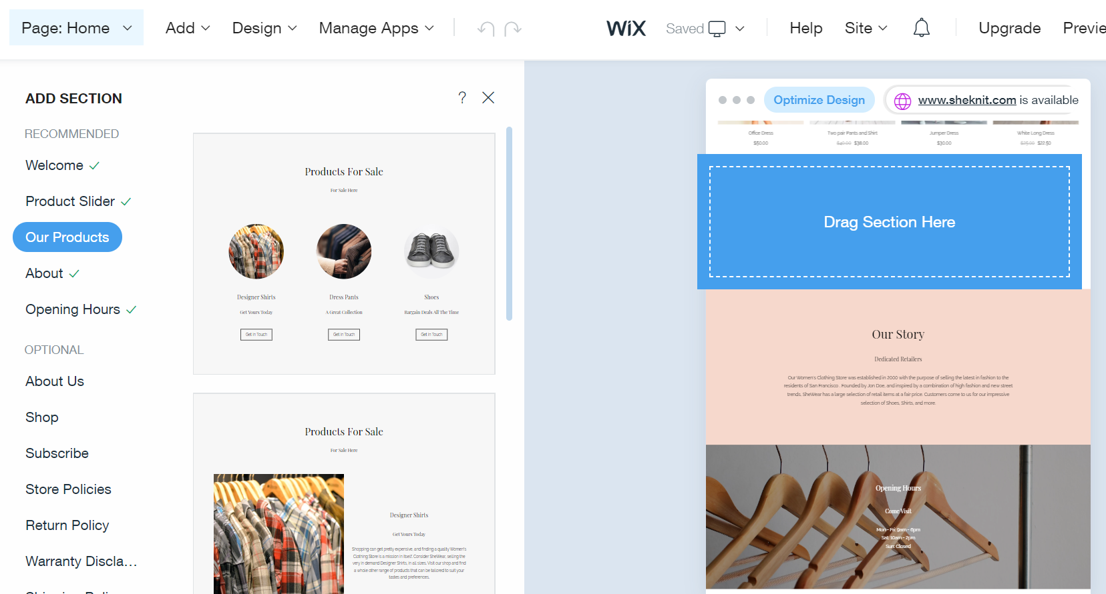
Customizing the site (Adding New Sections)
You’ll see that there’s really a lot of different content sections to pick from. Luckily, to make this easier, sections come pre-categorized.
You can grab any section from the sidebar and drag-and-drop it onto the canvas to the right.

Slide 9
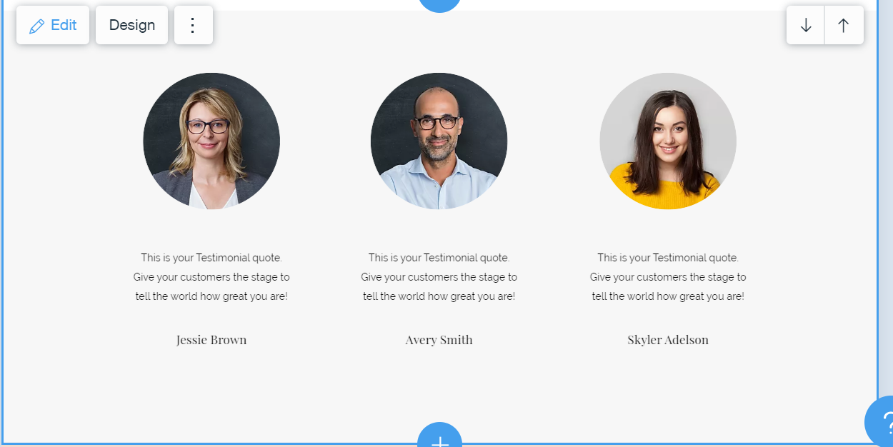
Customizing the site (Adding New Sections)
For example, here’s what a testimonial section looks like when added to the page.
As you would expect, you can fine-tune any little detail about that testimonial section and the texts inside of it.

Slide 10
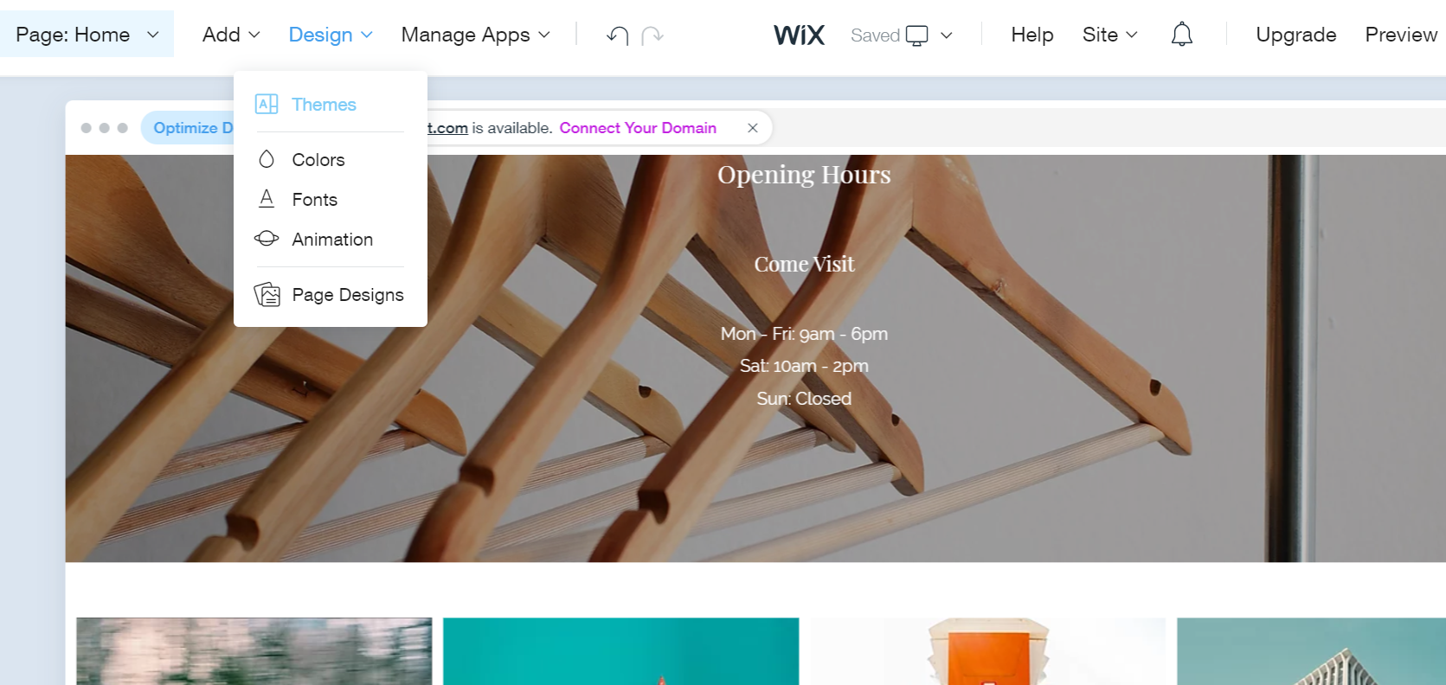
Customizing the site (Setting Fonts and Colours)
When you get started with the Wix ADI editor, you’ll get a pre-defined color scheme and font settings right out the gate. Those are good enough in most cases, but you can change them easily to get a more fine-tuned look.

Slide 11
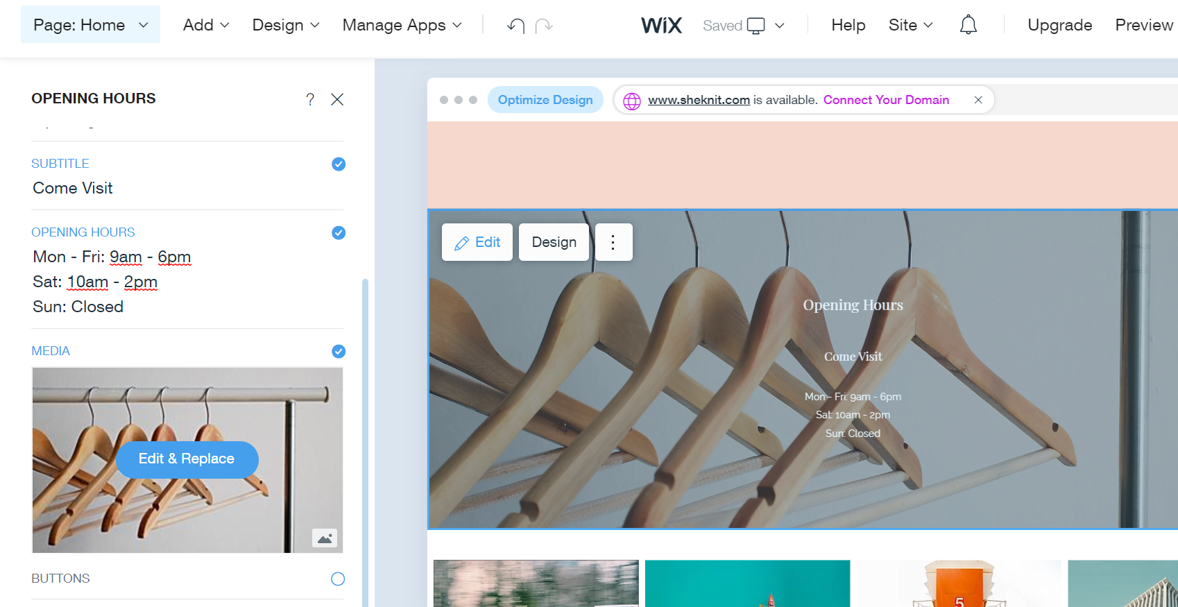
Customizing the site (Adding Images, Slideshows, And other Visual Features)
This will allow you customize the image in this section.

Slide 12
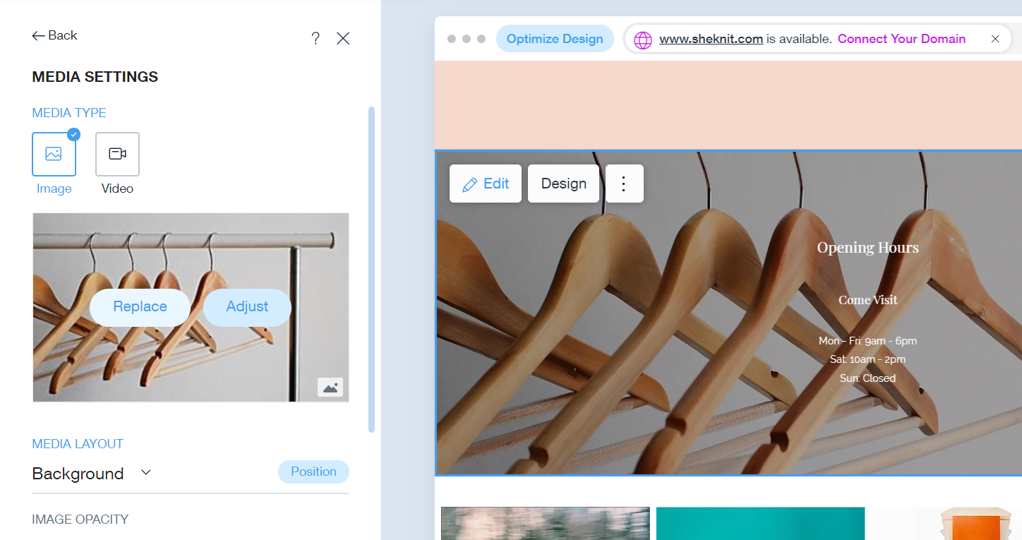
Customizing the site (Adding Images, Slideshows, And other Visual Features)
If you want to replace the image, simply click on the Replace button. You’ll see that Wix has a range of recommended images following the same theme. These are images that you can use on your site freely without having to worry about any copyright issues.

Slide 13
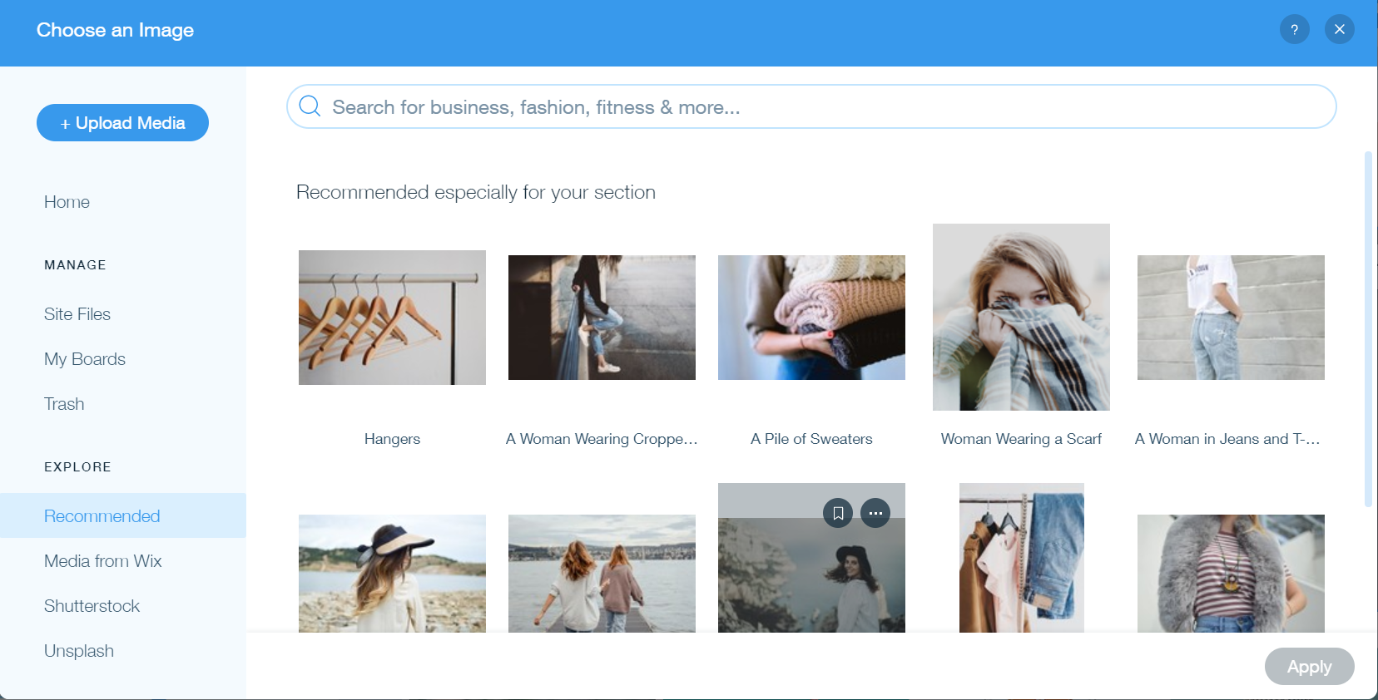
Customizing the site (Adding Images, Slideshows, And other Visual Features)
Use this button to upload your own images and/or media

Slide 14
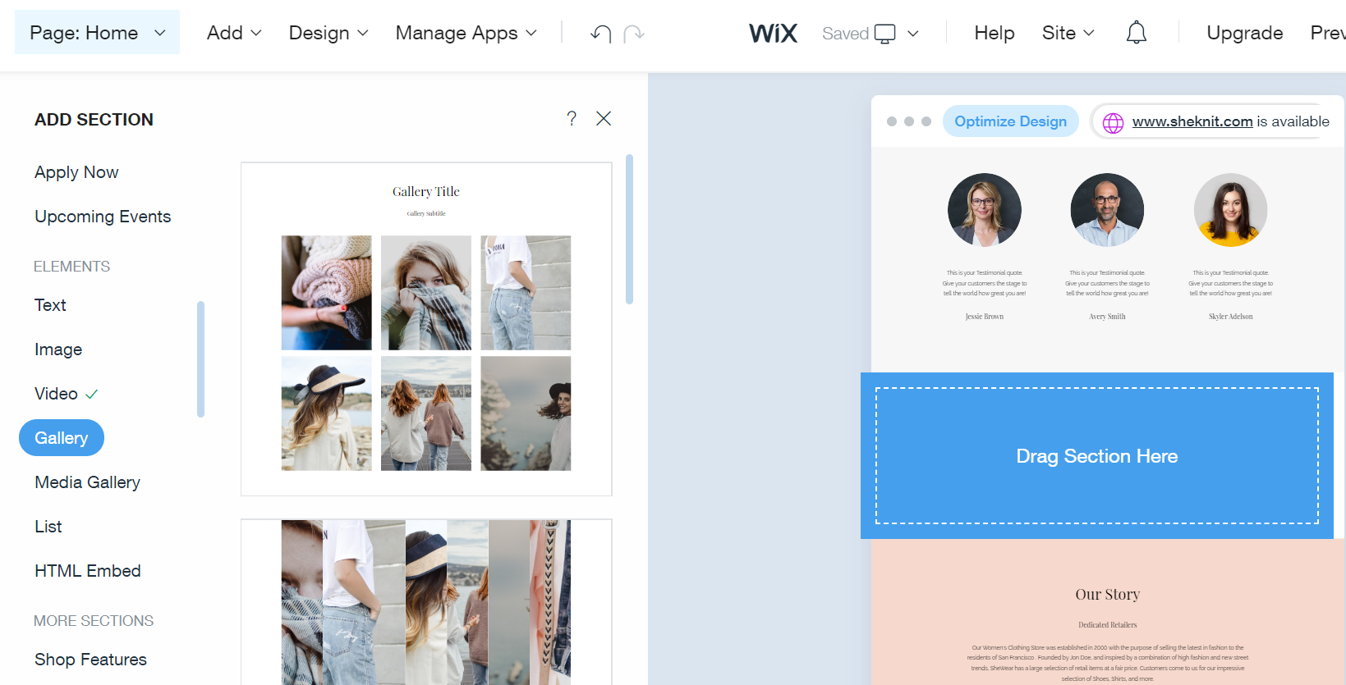
Customizing the site (Adding Images, Slideshows, And other Visual Features)
The procedure is very similar to adding or replacing images. Just click into the block the same way, then click on Edit & Replace, and organize your media accordingly.

Slide 15
Activity 11.1
Refer to your book for Activity 11.1

Slide 16
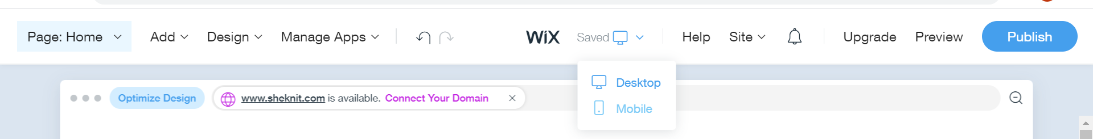
Tune-up site for Mobile Device
Luckily, getting your site mobile-optimized with Wix is easy. To begin, click on the view switcher button that’s in the top bar.

Slide 17
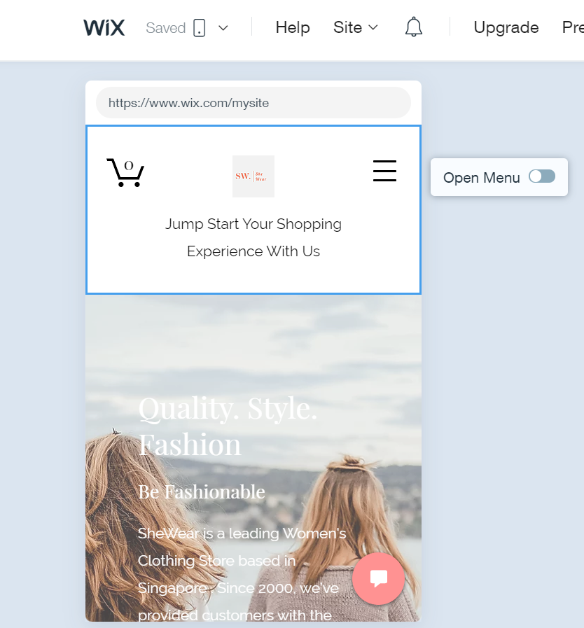
Tune-up site for Mobile Device
Once the website is optimized for mobile this will reload the page and show you how it’s going to appear on mobile devices.

Slide 18
Activity 11.2
Refer to your book for Activity 11.2

Slide 19

Tune-up site for Mobile Device
Here’s what you can do that’s generally going to make your site better on mobile:
hide images that aren’t crucial and just take up
space on the mobile view
put your contact info higher up on the page
– people want to get to that quickly
highlight only your main product or service
Wix lets you customize really a lot here regarding hiding different elements on the page, realigning entire sections, and so on. Take advantage of this and experiment.

Slide 20
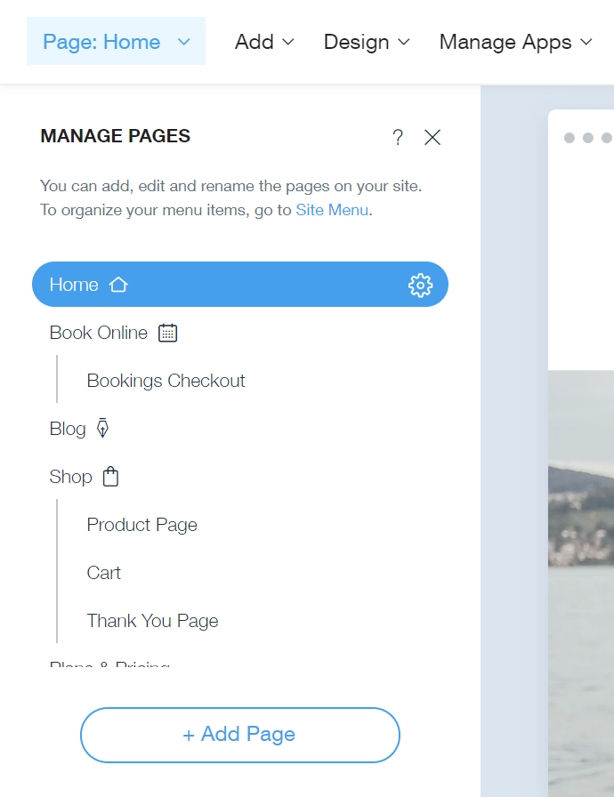
Create other Pages
To get started, click on the Page: Home button that’s in the top left corner. Then, click on + Add Page.
Wix already suggests some popular types of pages you might be interested in creating. Not by accident, the first suggestion on the list is for the About page.

Slide 21
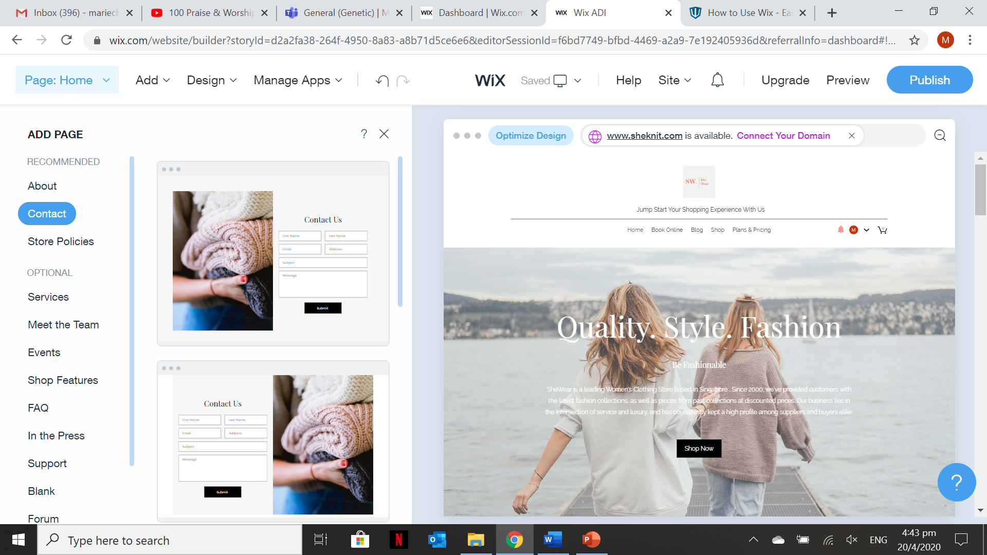
Create other Pages
Wix not only suggests pages you can build but also has some pre-made designs ready for each page.
The Wix ADI editor will reload the interface and let you work on your new Contact page.

Slide 22
Activity 11.3
Refer to your book for Activity 11.3

Slide 23
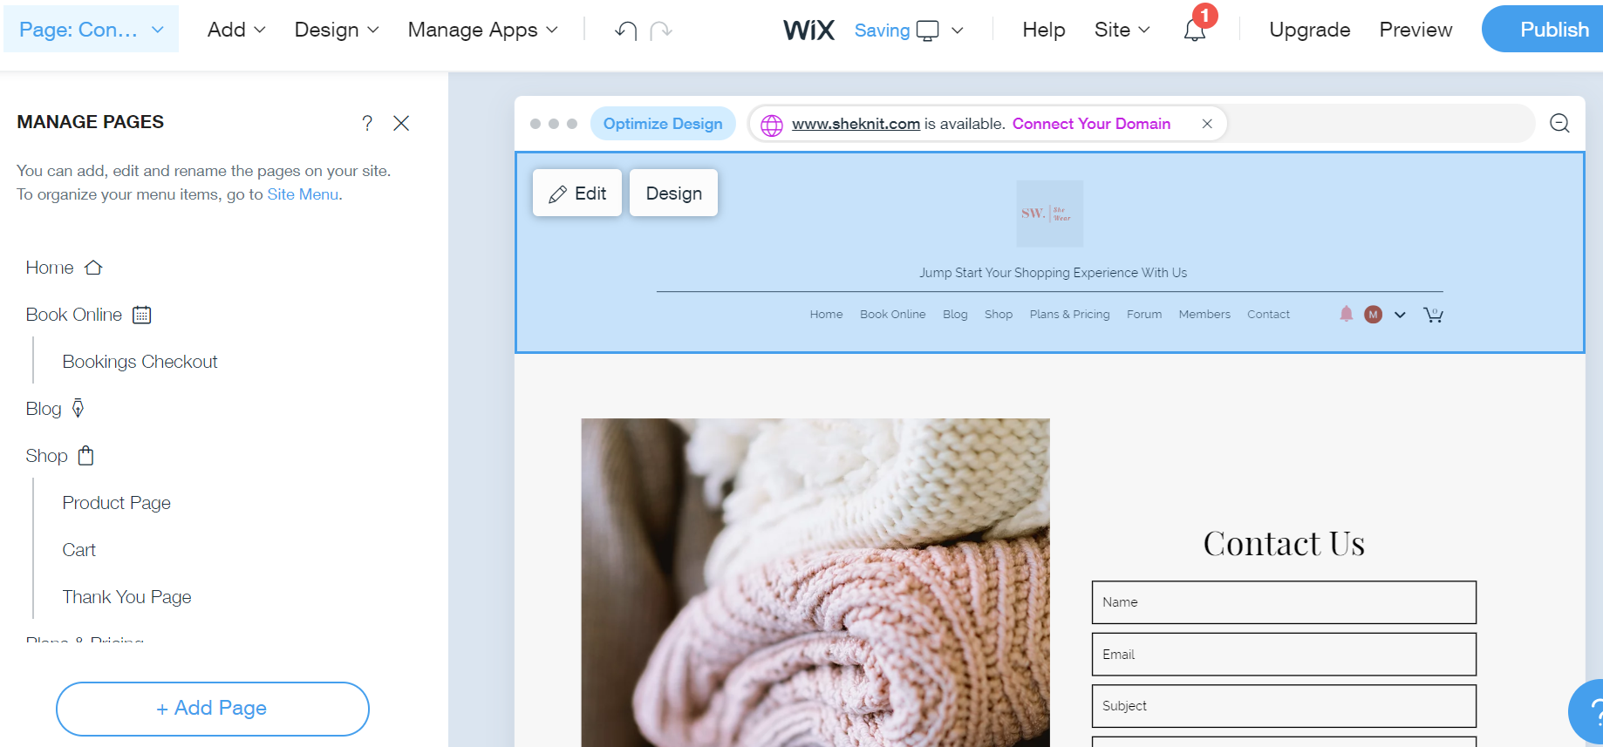
Fine-tuning site Navigation
By default, each new page you create is going to be added to the main menu of your site automatically.

Slide 24
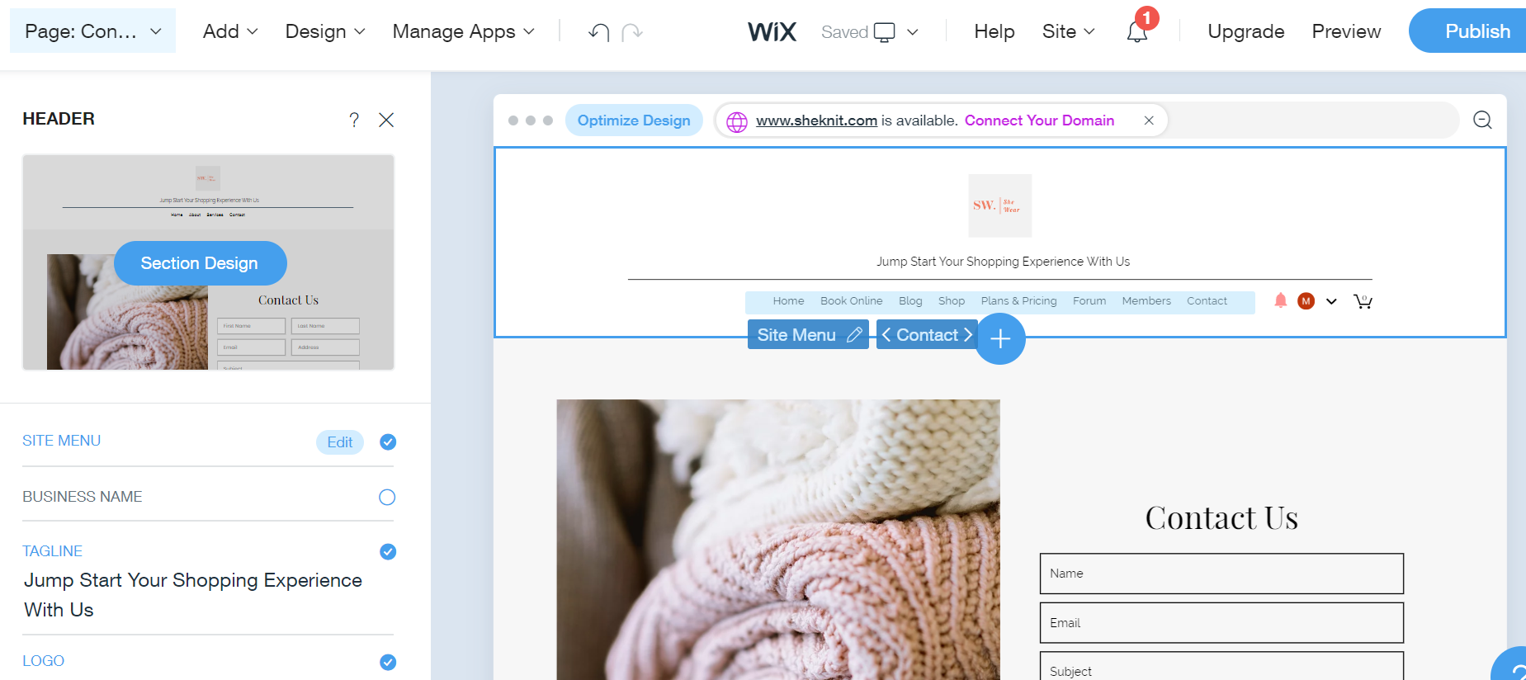
Fine-tuning site Navigation
If you want to change the order in which the pages appear in the menu, click on your site’s header, and then on the Edit button next to MENU.

Slide 25
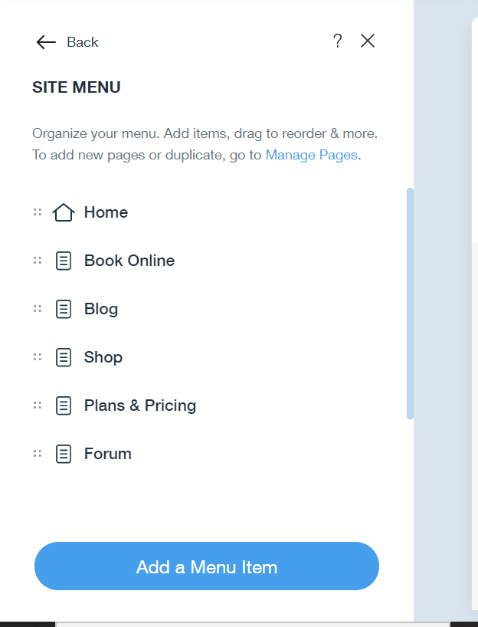
Fine-tuning site Navigation
You’ll be able to drag-and-drop pages to reorder them.
You can also add menu items by hand if you want to link to places outside of your website (like your social media profiles, for instance).

Slide 26
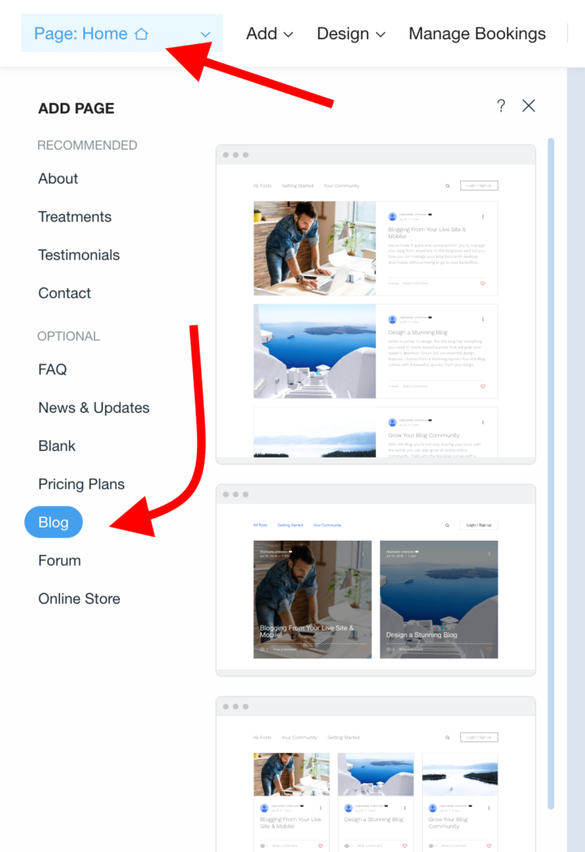
Adding a Blog
From the top menu, click on the Page button and then on + Add Page. From the list, select Blog and then pick a blog layout that you like.
The exact layout you choose is purely up to you. All of them will work great! The Wix editor will reload, and you’ll see your new blog page in action.

Slide 27
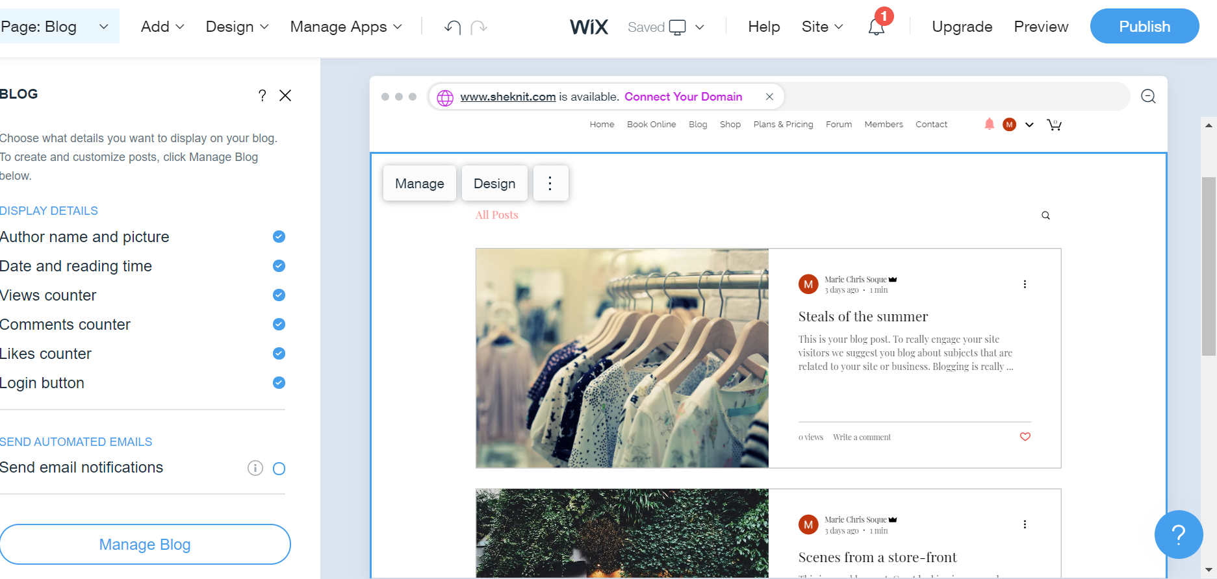
Adding a Blog
Add, Edit and Delete Blogs click the Manage blog button and you will be redirected to the Wix Dashboard which allows you to manage your blog posts.

Slide 28
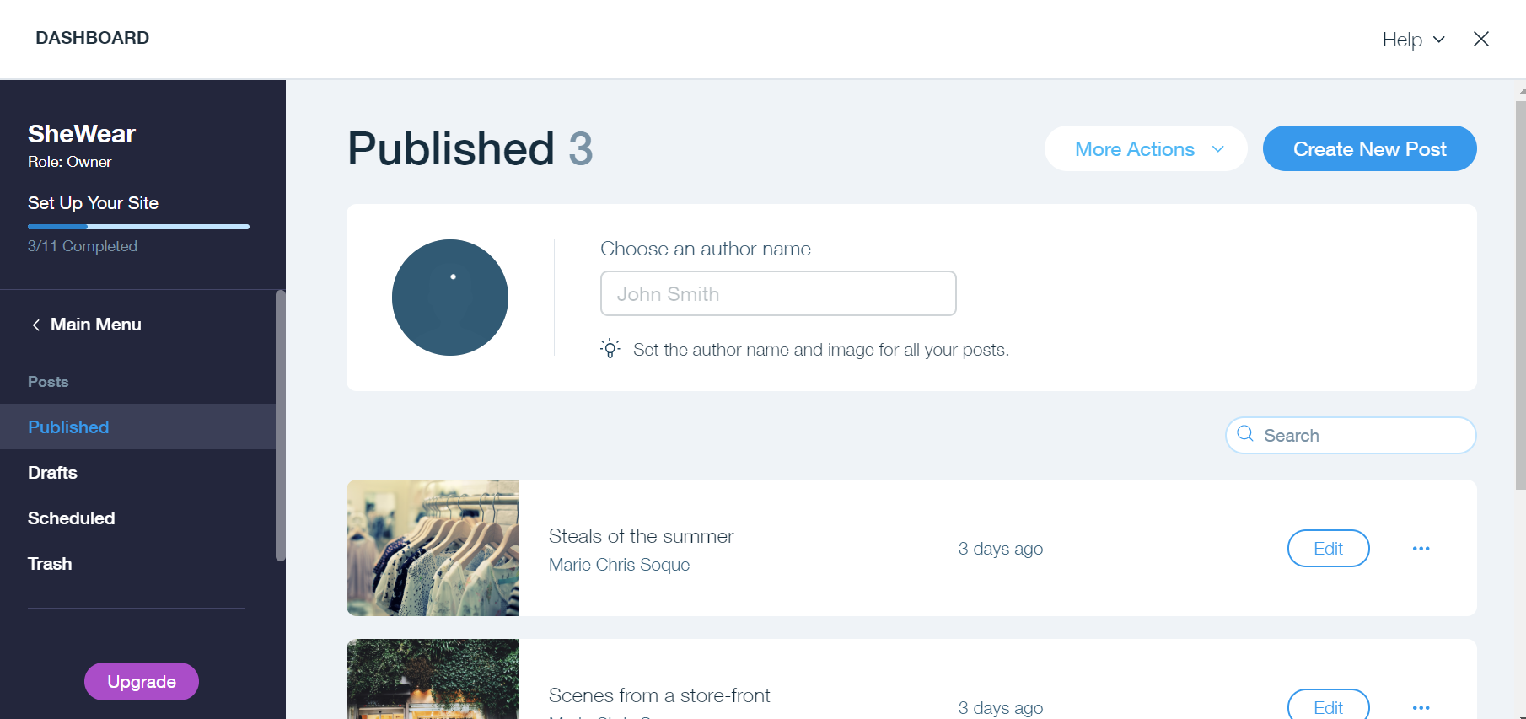
Adding a Blog
By default there are three sets of blog created in the Wix ADI and these are pre-selected together with the Wix ADI template chosen during set-up.
From here, you can manage existing posts as well as create new ones.

Slide 29
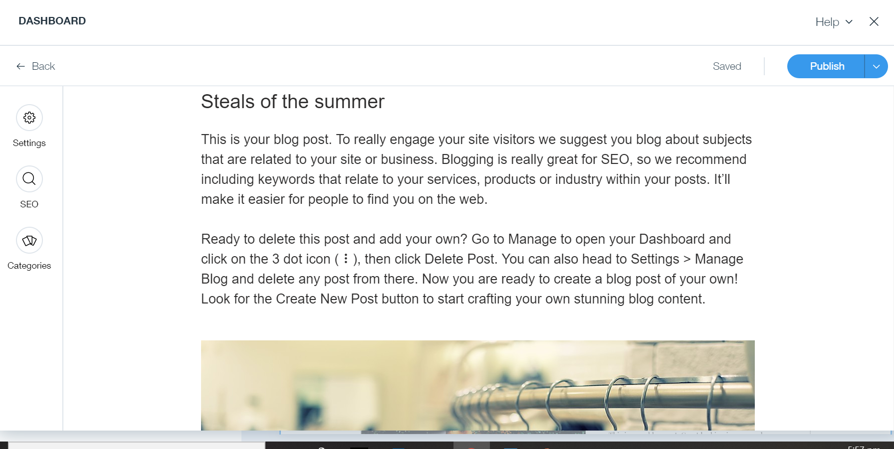
Adding a Blog
This is the section where you can edit the selected blog posts.

Slide 30
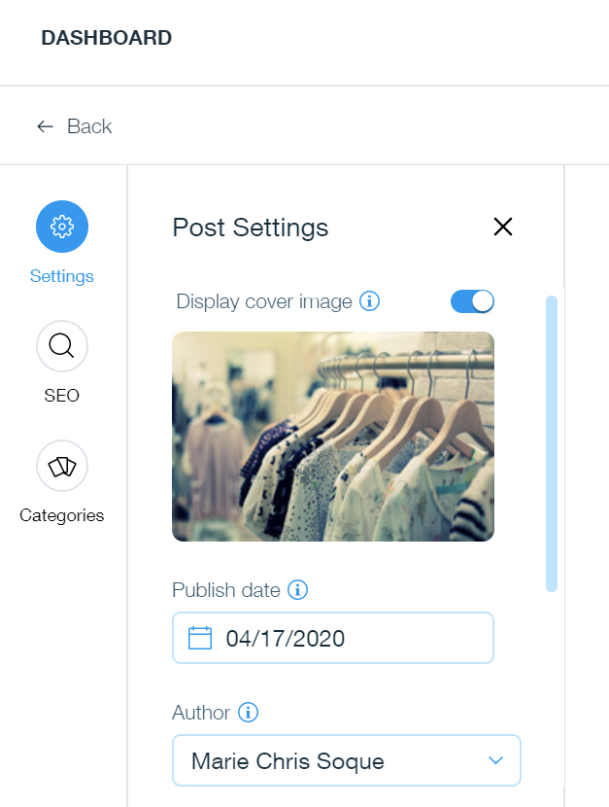
Adding a Blog
In the settings, you can change the publish date, the author, excerpt and set the post as featured post.

Slide 31
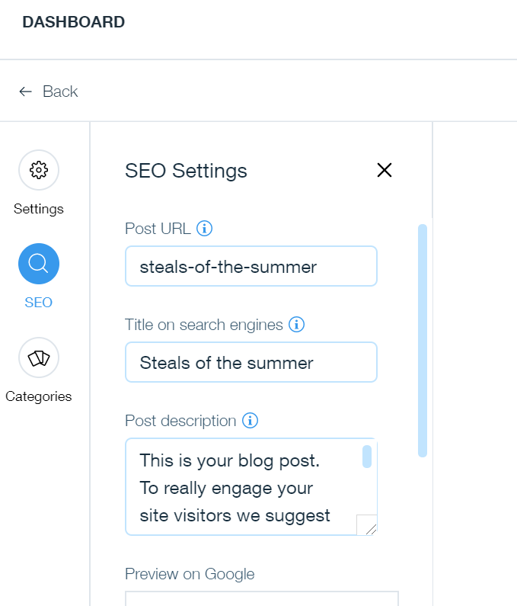
Adding a Blog
The SEO is a very important setting of a blog post.
Whatever values set on the given properties will be considered by Search Engines to improve the ranking of your website.

Slide 32
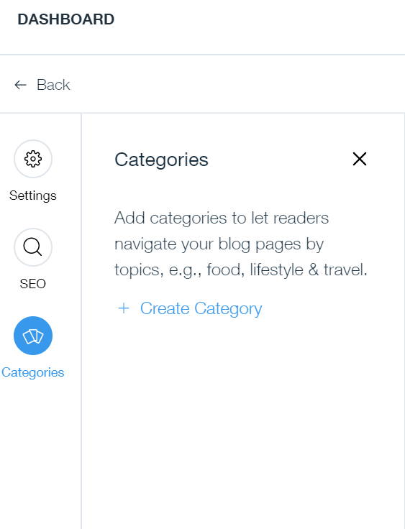
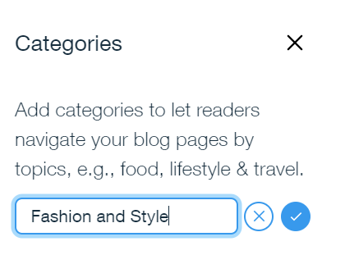
Adding a Blog

Slide 33
Activity 11.4
Refer to your book for Activity 11.4

Slide 34
Portfolio – Managing Wix Site
The contents of your portfolio for this lesson are the following:
Added Testimonial Section
Changed and customized the images, gallery, slideshows & etc.
Tuned-up the website for mobile device
Added Pages (Contact, Store Policies, Forum)
Customized the navigation of the Site
Added two blog posts

